Slide 1

Customer Retention
Flip Robo Technologies
Report by
Alfinson John

Slide 2

What is Customer Retention?
Customer retention refers to the activities and actions companies and organizations take to reduce the number of customer defections. The goal of customer retention programs is to help companies retain as many customers as possible, often through customer loyalty and brand loyalty initiatives. It is important to remember that customer retention begins with the first contact a customer has with a company and continues throughout the entire lifetime of the relationship

Slide 3
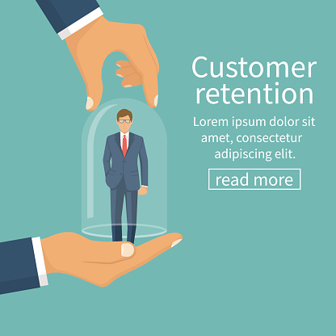
Customer Retention Benefits
While most companies traditionally spend more money on customer acquisition because they view it as a quick and effective way of increasing revenue, customer retention often is faster and, on average, costs up to seven times less than customer acquisition. Selling to customers with whom you already have a relationship is often a more effective way of growing revenue because companies don’t need to attract, educate, and convert new ones.

Slide 4
Benefits
Companies that shift their focus to customer retention often find it to be a more efficient process because they are marketing to customers who already have expressed an interest in the products and are engaged with the brand, making it easier to capitalize on their experiences with the company. In fact, retention is a more sustainable business model that is a key to sustainable growth. The proof is in the numbers according to studies done by Bain & Company, increasing customer retention by 5% can lead to an increase in profits of 25% – 95%, and the likelihood of converting an existing customer into a repeat customer is 60% – 70%, while the probability of converting a new lead is 5% – 20%, at best.

Slide 5

How to Improve Customer Retention
Set customer expectations – Set customer expectations early and a little lower than you can provide to eliminate uncertainty about the level of your service and ensure you always deliver on your promises.
Become the customers’ trusted advisor – You need to be the expert in your particular field, so that you can gain customers’ trust and build customer loyalty.
Use relationships to build trust – Build relationships with customers in a way that fosters trust. Do this through shared values and fostering customer relationships.
Take a proactive approach to customer service – Implement anticipatory service so that you can eliminate problems before they occur.
Use social media to build relationships – Use LinkedIn, Twitter, and Facebook to connect and communicate with customers and give them a space for sharing experiences with your company, so they can become brand ambassadors.
Go the extra mile – Going above and beyond will build strong relationships with customers and build long-term loyalty by paying attention to their needs and issues.

Slide 6

Customer Retention Tactics
Poor customer service brings 70% of customer loss
Always ask for feedback from customer
Listen first, understand and then talk
Bring your customers together
Give priority and importance to customers always
Find out what makes customer to stay or leave
Analyze customer feedback to gain valuable insights and ensure that right person hear it.

Slide 7
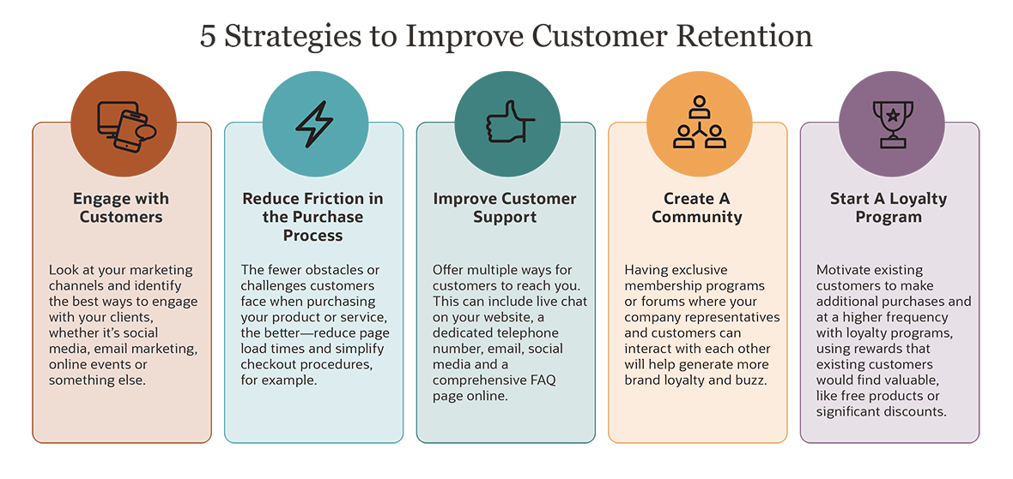
Strategies for Improvement

Slide 8

How Can a CRM System Help With Customer Retention?
A customer relationship management (CRM) system gives businesses a central view of its customers, with contact information, order history, previous communication and their response to different marketing campaigns or promotions. It offers valuable insights into their behavior and the most effective ways to reach these customers so your company can target them with personalized offers. A CRM system also helps you see where customers are dropping off in the customer acquisition or retention process.

Slide 9
Online Retailers Preferred

Slide 10
Who is our potential customer?
21 – 50 Years are potential age who covers
85% sales
> Females are the
Potential customer
67.29%

Slide 11
Top 10 Cities for e-commerce

Slide 12
Shopping Pattern
Since how long you are shopping online?
How many times you have made an online purchase in the past 1 year?

Slide 13
How they do shopping?
Devices Used
Browser

Slide 14
How Customer reached to online website?
Customers are somehow know what they need so that they search on search engine like Google

Slide 15
Customer habit on ecommerce

Slide 16
Website content

Slide 17
Which of the Indian online retailer would you recommend to a friend?

Slide 18
Performance during promotion, sales period

Slide 19
Privacy of Customer
Perceived Trustworthiness

Slide 20
Platform Technical performance
Reliability of the website or application
Conclusion:
Amazon is technically best platform as per customer choices
Flipkart is on the 2nd position in this category
Paytm secured 3rd position on platform stability
Myntra is on 4th position
Snapdeal is on 5th position

Slide 21

Conclusion
Customer retention doesn’t improve overnight. However, if you have a few solid strategies up your sleeve, you can coax your existing customers back for more.
First, know your customers. Figure out what they want and need and where their pain points lie.
Next, find ways to surprise, delight, and motivate them. Get in touch. Ask for feedback and testimonials. Help them realize you appreciate their patronage.
Using tools like crazy Egg, you can test every strategy you try and continuously refine your approach. The more you test, the stronger your customer retention program becomes.

